Slide 2
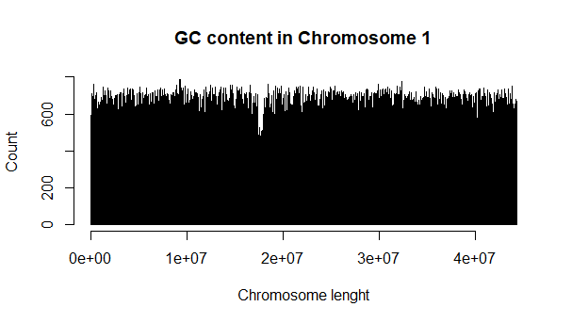
Window = 1000

Slide 3
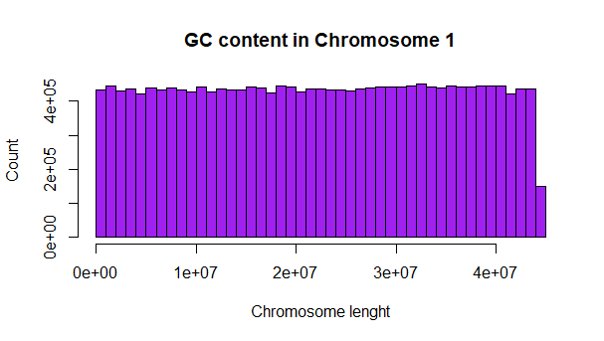
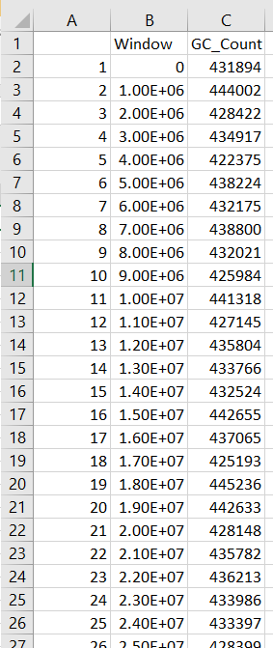
Window = 1000000

Slide 4
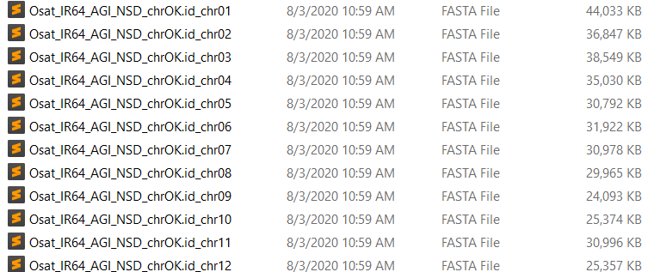
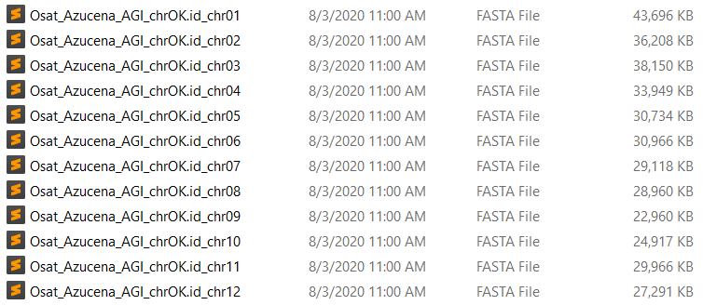
Now, to compare genomes we need to use references coords
Aligned by Mummer

Slide 5
How use these coords?
Chr 1 IR64
Chr 1 Azucena
Pos r | Base r
1 | A
2 | T
3 | C
… | …
n | N
Pos q | Base q
1 | C
2 | C
3 | T
… | …
n | N
COORDS FILE
S1 E1 S2 E2
1 10 30 40
115 143 60 90
Pos r | Base r | Pos q | Base q
1 | A | 30 | A
2 | A | 31 | A
3 | T | 32 | T
4 | C | 33 | C
5 | T | 34 | T
6 | G | 35 | G
… | … | … | …
10 | N | 40 | N
This subset has to be extracted for each line of coords.
The last step is to combine these subsets one after other in a big data frame
Task to go crazy
Aprox 40 Million of bases
in each chromosome and
5209 coords lines
The idea is extract subsets of query data using Pos r, example:
Extract cells from Chr1 Azunacena between Pos q (30-40), and put them together in a dataframe with cells from 1 to 10 from IR64
This will give a result as:
…

Slide 6
After got crazy for several days, I discover this simple method
COORDS FILE
S1 E1 S2 E2
1 10 30 40
115 143 60 90
Base/Motif | Pos q | Pos r
A | 35 | 5
TTTTTTTTT | 77 | 131
For Base A in Pos q 35 -> Search interval in query coords
Difference between Pos q and S2 -> 35-30 = 5
Add this difference to S1 => 1 + 5 = 6
Subtract one = > 6 – 1 = 5 This is the position in Pos r
For Motif TTTTTTTTT Pos q 77:
77 – 60 +115 – 1 = 131 Pos r

